Slide 1


UN Rapid Assessment Project
Team Mozart
Daizhen Zheng
Long Wan
Travis Park
Qi Zhang

Slide 2
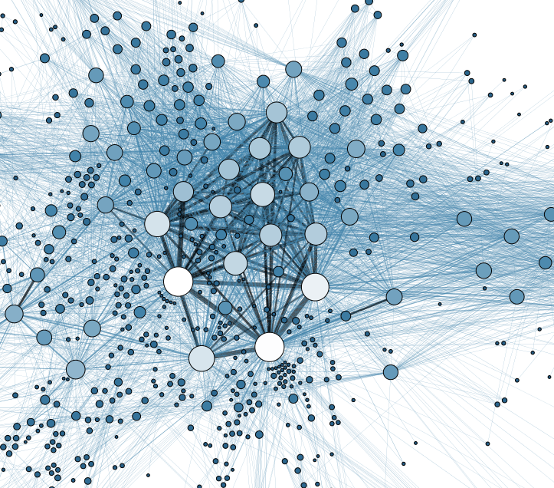
Project Overview
Agenda
Status as of last meeting
Progress since last meeting
Two step approach
Strong label generation
Label Spreading and Positive Naive Bayes Classifier
Future plans

Slide 3

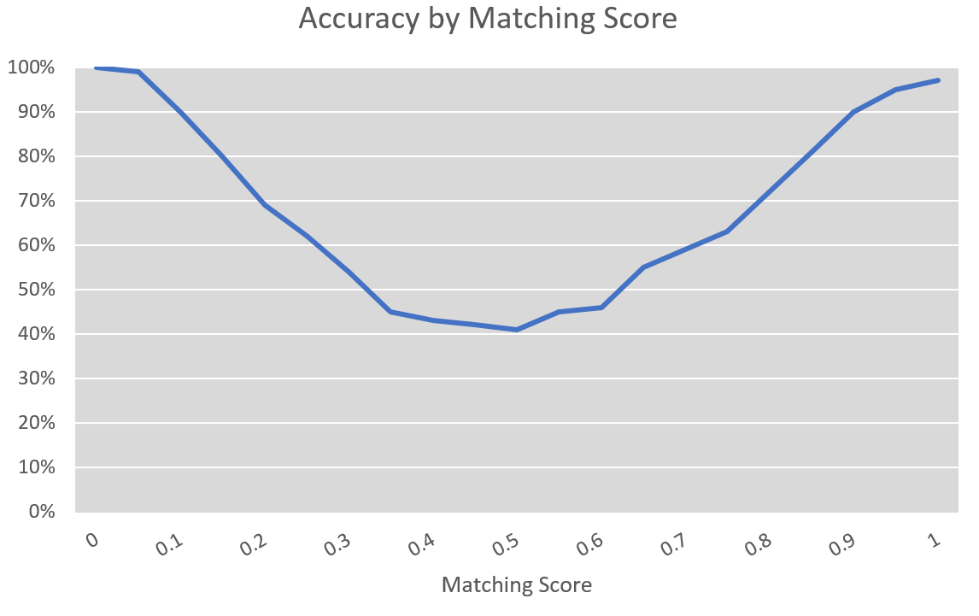
Recap
Method
Common words to match paragraph to target
Results
Low accuracy overall
Extremes were very accurate
Reasons
Too many targets
Targets share words

Slide 4
Progress
Method
Two Step approach
Classify Goal, then Target
Strong Label Generation
Use highly accurate extremes from common words method to generate a training set for machine learning
Label Spreading
Positive Naive Bayes Classifier

Slide 5
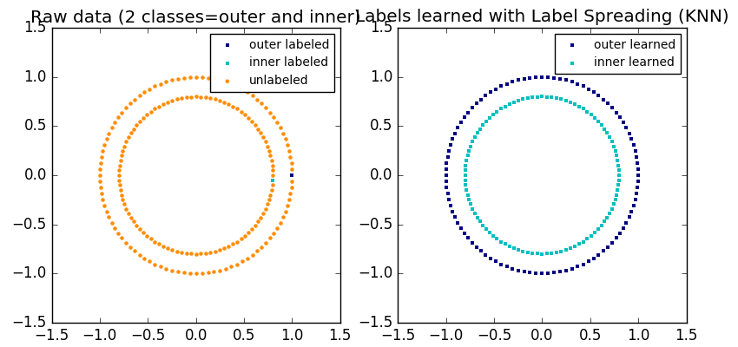
Label Spreading
Semi-Supervised Learning
Takes a sparsely labelled dataset as input
Finds natural clusters in the data to extend labels to unlabelled records

Slide 6
Positive Naive Bayes Classifier
Classification method that takes only true text as training data
Returns True/False if input text is related to training data
Method
Use high confidence common words method to define true data set
Feed uncertain paragraphs into model

Slide 7
Future Plans
Sector designator model
Match a paragraph to a set of predefined sectors to build final deliverable
Automation
Package script into one user friendly system
Generate Target-Sector Matrix

